Slide 1

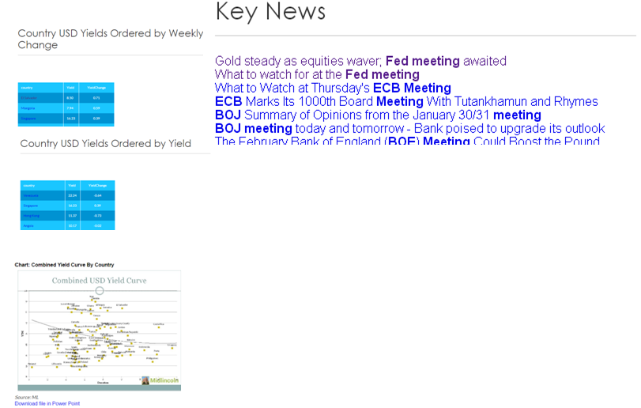

Fixed Income Weekly/Monthly
Bonds Datamine Queries
Top 20 GEM Sovereign Bonds Yields Climbs Change USD Eurobonds (Losers) Weekly Top 20 GEM Sovereign Bonds Yields Drops Week Change USD Eurobonds (Winners) Top 10 GEM Corporate Bonds Yields Climbs Week Change USD Eurobonds (Losers) Top 10 GEM Corporate Bonds Yields Drops USD Eurobonds (Winners) Weekly Country Average Sovereign Yield Change USD Eurobonds Weekly Country Average Corporate Yield Change USD Eurobonds Weekly Top 30 GEM Sovereign Eurobonds by Yield Top 30 GEM Corporate Eurobonds by Yield Top 30 GEM Local (reasonably rated) Currency Bonds by Yield Big Country Table - Stance, Ratings and Datamine Top 20 Developed Markets Sovereign Bonds Yields Climbs Change USD Eurobonds (Losers) Weekly Top 20 Developed Markets Sovereign Bonds Yields Drops Change USD Eurobonds (Winners) Weekly Top 10 Developed Markets Corporate Bonds Yields Climbs Week Change USD Eurobonds (Losers) Top 10 Developed Markets Corporate Bonds Yields Drops Week Change USD Eurobonds (Winners) Top 30 DM Souvereign Eurobonds by Yield Top 30 DM Corporate Eurobonds by Yield
Power Point

